Slide 1

A semi-supervised solution for mesothelioma classification
Jiang Peichun s330592
Khattar Reem s321463
Tallone Samuele s334046

Slide 2
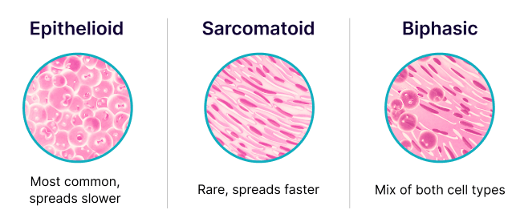
Cancer overview
Malignant pleural mesothelioma (MPM) is a rare cancer originating from the mesothelial cells of the pleura. It is strongly associated with asbestos exposure
Epithelioid subtype:
accounting for approximately 60–80% of cases
composed of uniform epithelial-like cells and exhibits a tubulopapillary or solid growth pattern.
better prognosis and higher treatment responsiveness
Sarcomatoid subtype:
accounting for approximately 10–20% of cases
more aggressive variant consisting of spindle-shaped cells
associated with poor therapeutic response and a worse overall prognosis
Biphasic subtype:
contains both epithelioid and sarcomatoid components
the clinical behavior lies between the two
prognosis worsens as the sarcomatoid component increases

Slide 3
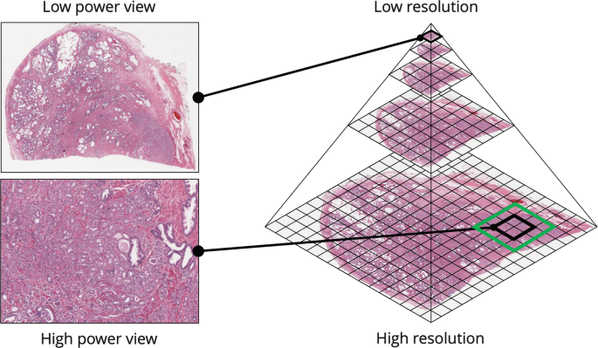
WSI and MIL paradigm
Whole Slide Images (WSI): pyramid structure
WSI stores the same image at multiple resolutions, creating a stack of layers. At the base, there is the full-resolution image with all its detail. As moving up the pyramid, each level contains a progressively lower-resolution version of the same image.
require significant storage space
can be efficiently managed and navigated
Multiple Instance Learning (MIL)
weakly supervised solution
treating each WSI as a ”bag” of many small image patches, or ”instances”.
doesn’t require expensive pixel-level annotations
learn from slide-level labels by identifying the most discriminative instances within the bag

Slide 4
CLAM and PINS paper
Clustering-constrained Attention Multiple Instance Learning (CLAM)
uses an attention-based pooling function to aggregate the patch level features into a slide-level prediction.
assign importance scores to each patch, allowing the model to focus on tumor-rich regions while ignoring background artifacts.
introduces instance-level clustering, encourages the model to learn distinct representations for different tissue classes, improving both accuracy and interpretability.
able to produce heatmaps that allow clinicians to visualize the relevant regions

Slide 5
CLAM and PINS paper
Positive INstance Sampling (PINS)
Eastwood et al. (2023) proposed an approach which suggests that manually engineered features, such as nuclear size, cell density, and spatial distribution, can provide a robust numerical signature for cancer subtyping. As It was implemented on a smaller version of the dataset using Tissue Micro-Array (TMA) cores, the novelty of our project:
Implements a similar dual-path feature strategy on entire WSI.
Extracting these handcrafted features via QuPath and concatenating them with ResNet50 deep features
comparison with current state-of-the-art feature extractors

Slide 6
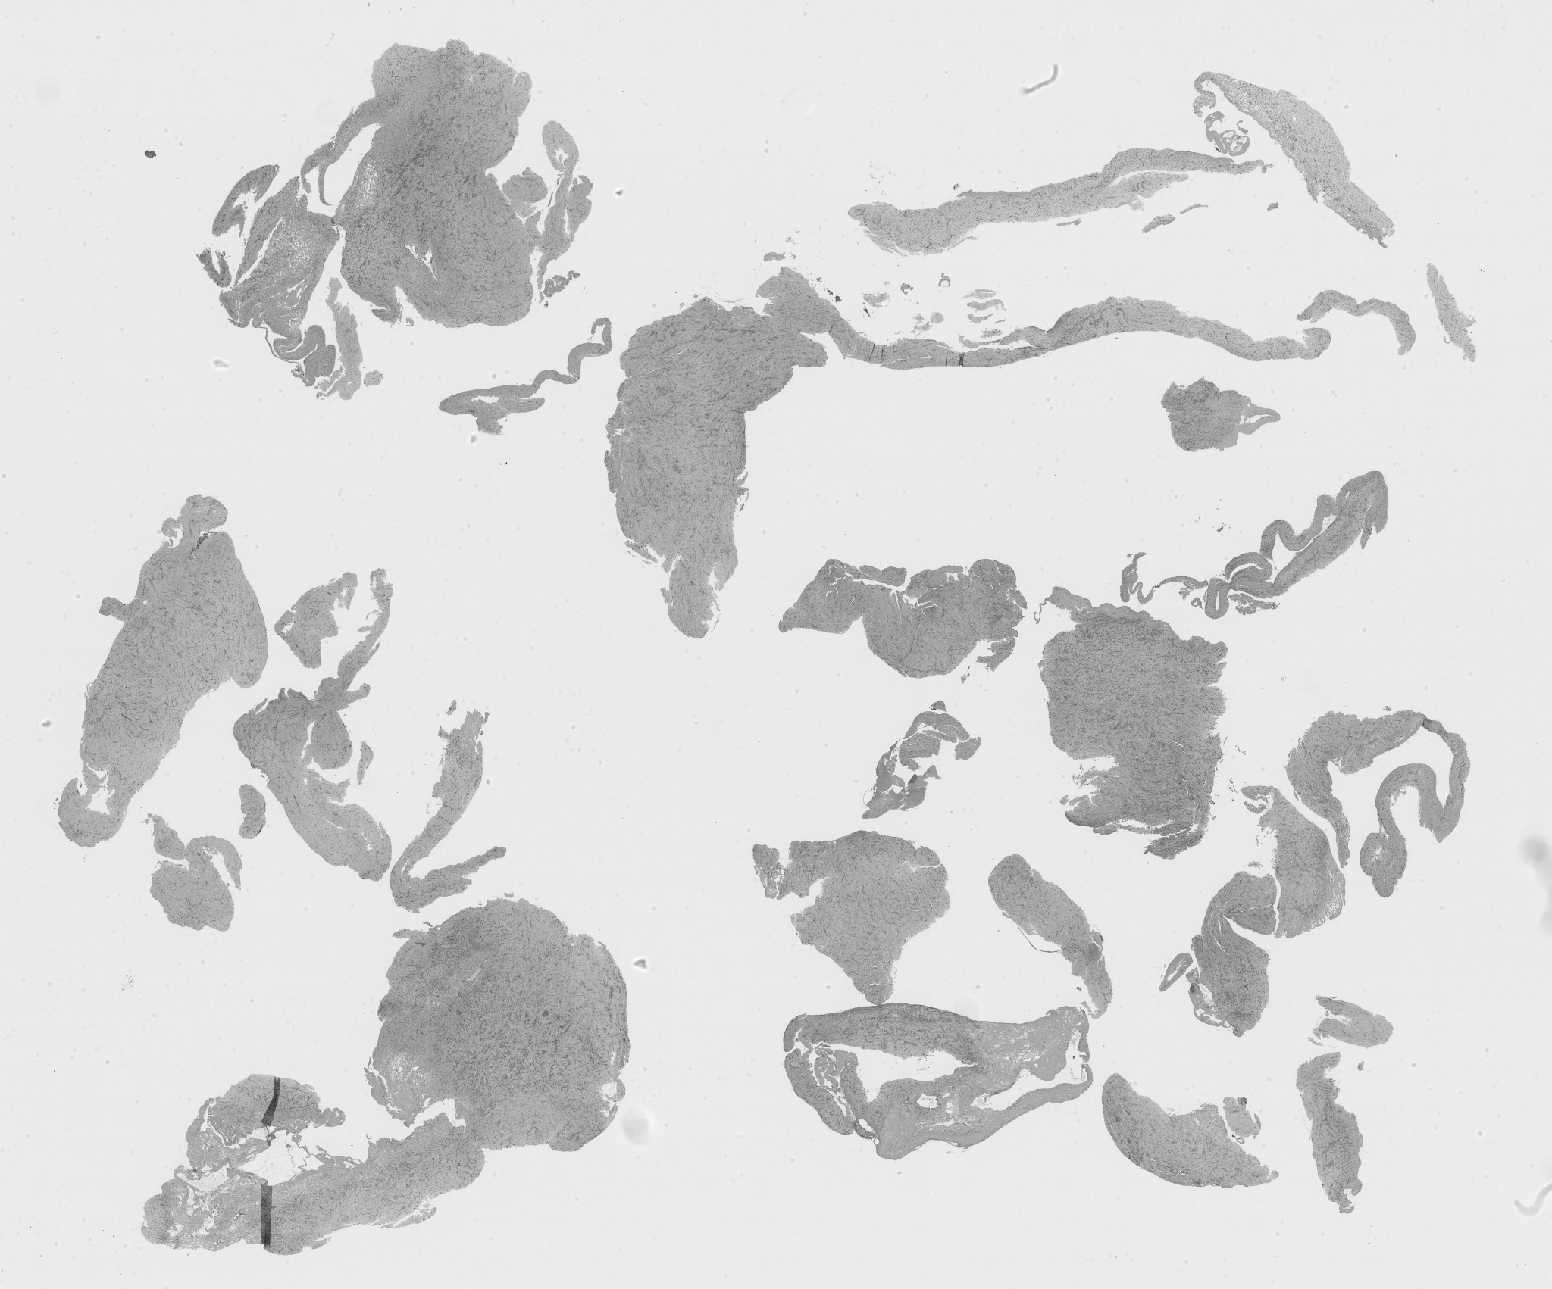
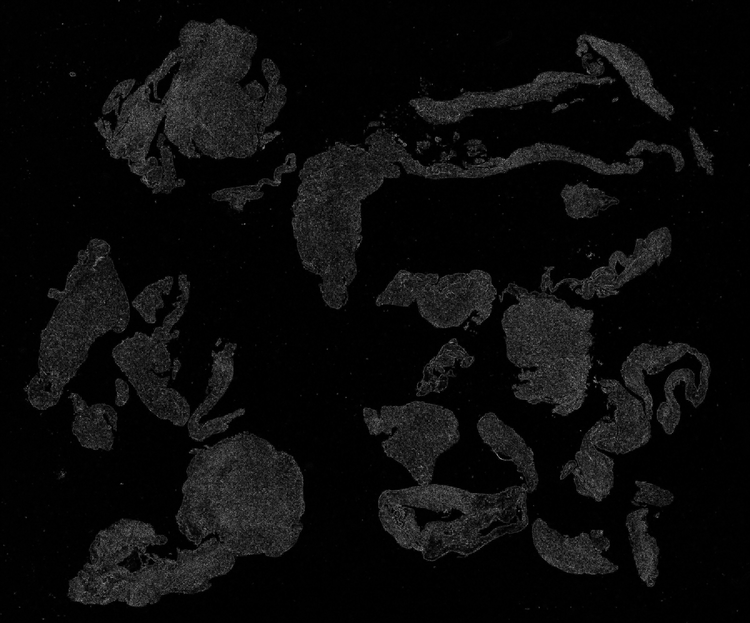
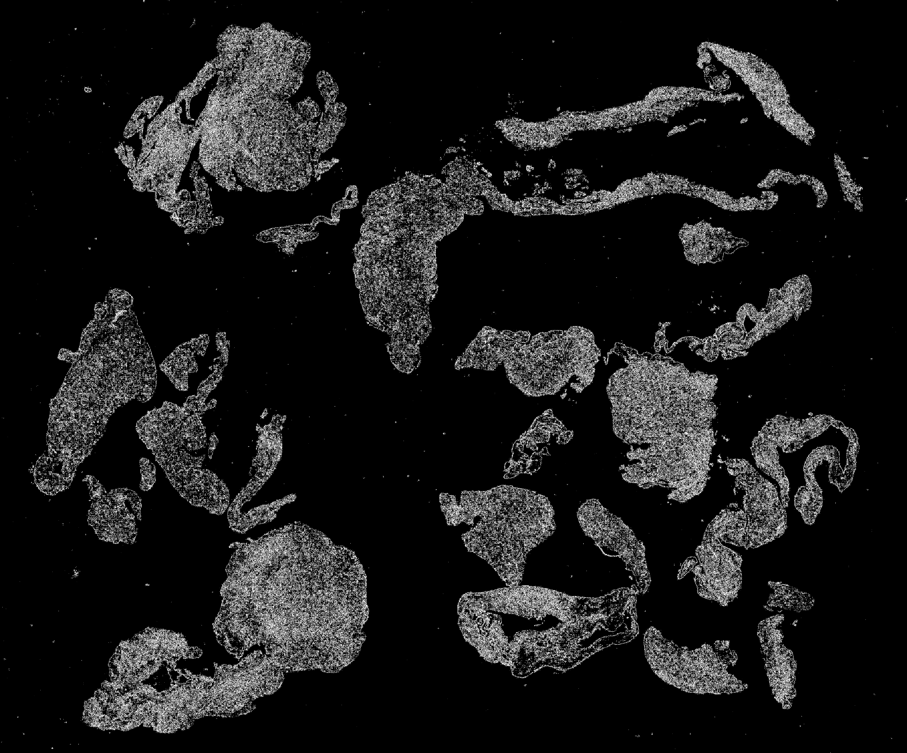
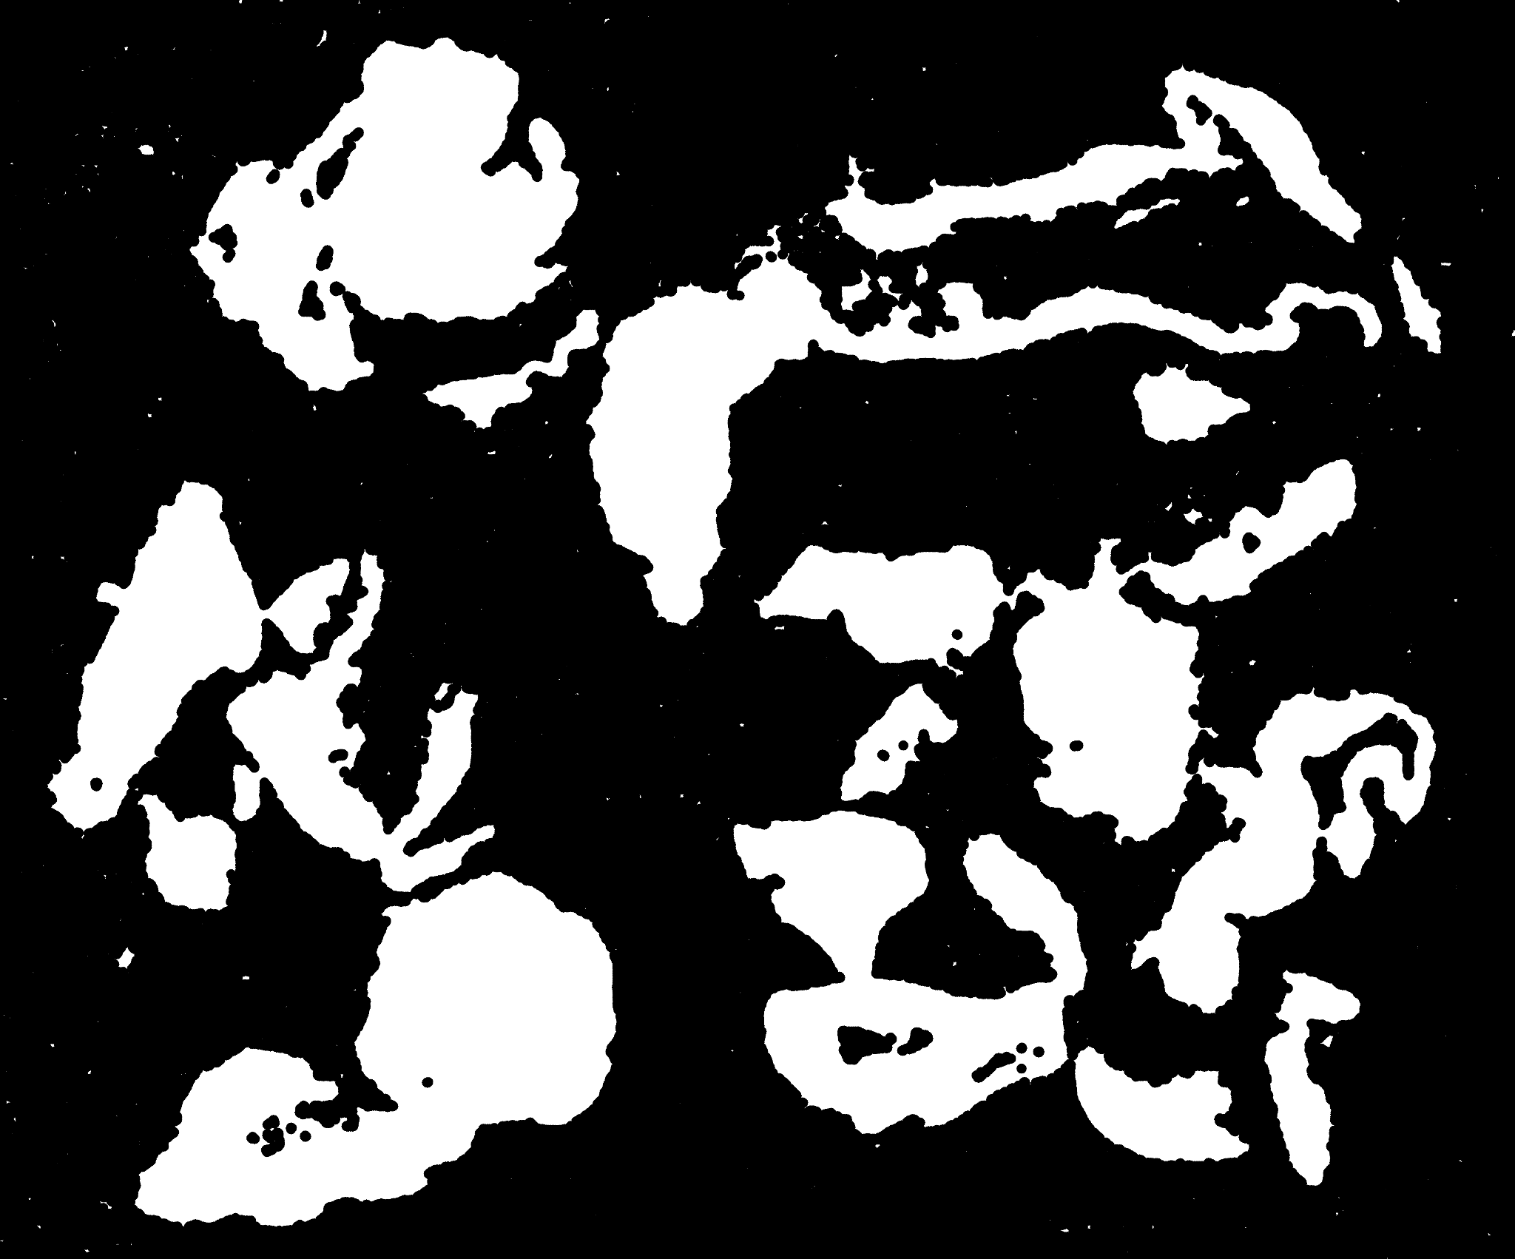

Methodology - Tissue segmentation
Grayscale
Laplacian
Otsu mask
Morph closing
Final mask

Slide 7
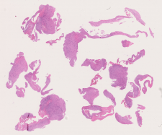
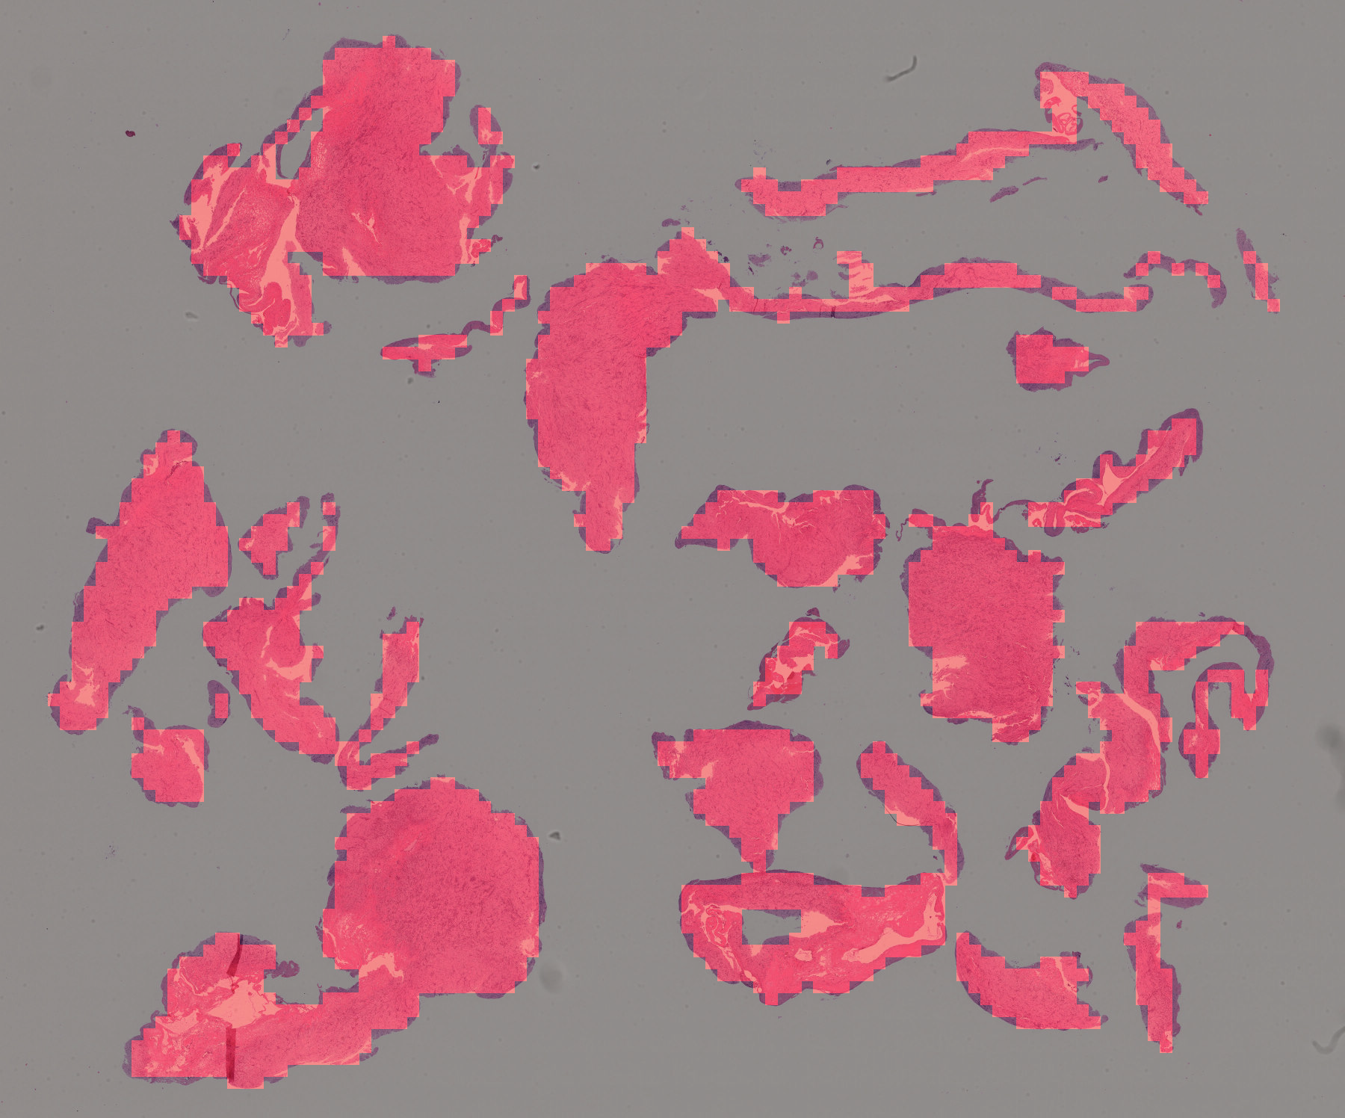
Methodology - Patch Extraction
Patches extraction: Patches were extracted at 512x512 pixels at level 0, meaning the level with the highest magnification.
Overlay creation: For each slide an overlay was created so that we could visually check the sanity of the patch extraction process
Thumbnail
Overlay

Slide 8
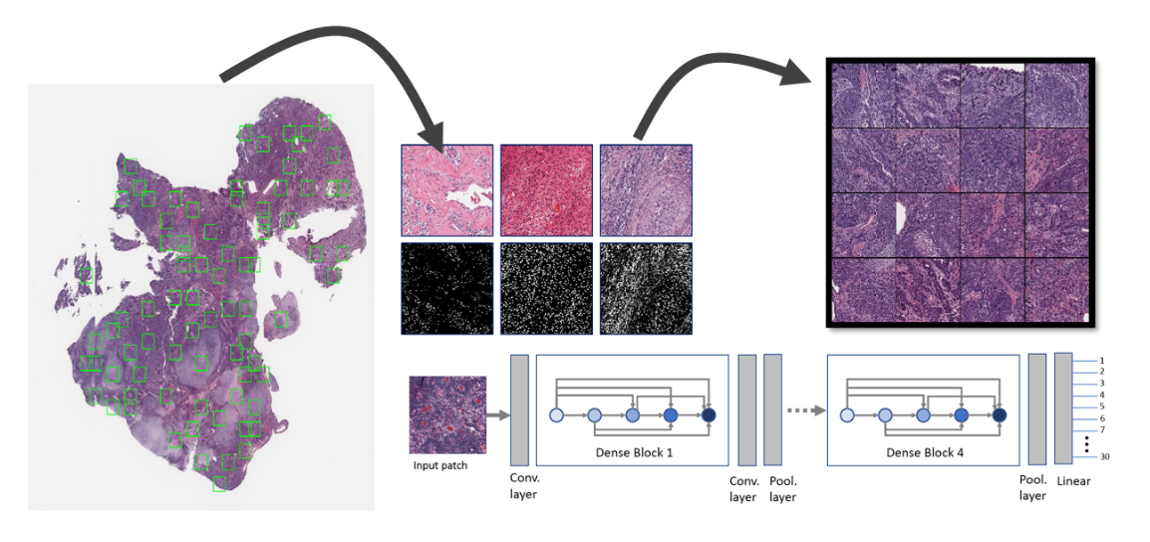
Methodology - Feature Extraction
KimiaNet
deep CNN based on DenseNet-121 architecture
trained on histopathology WSIs
produces discriminative deep features for medical image representation and analysis

Slide 9
Methodology - Feature Extraction
UNI
uses self supervised learning
built on Vision Transformer (ViT) architecture
trained on large-scale pathology datasets
learns tissue and cellular patterns automatically
produces embeddings usable for downstream medical tasks

Slide 10
Methodology - Feature Extraction
Manual Features
texture, intensity, spatial, morphological features,... extracted with QuPath
combined with ResNet50 deep learned features
encode domain knowledge that may not be easily captured by neural networks
enrich feature representation and improve model interpretability and performance

Slide 11
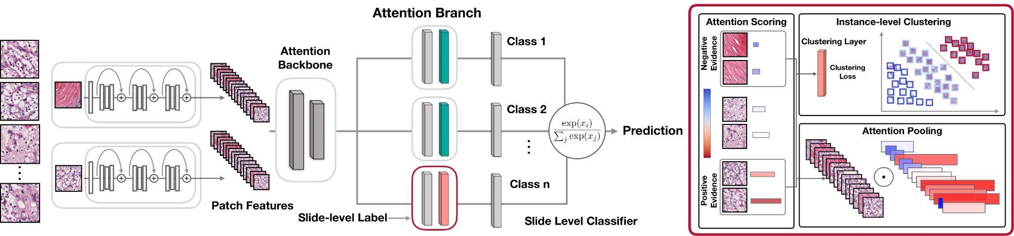
Methodology - Prediction Model
CLAM
Clustering-Constrained Attention Multiple Instance Learning
designed for WSI analysis using Multiple Instance Learning (MIL)

Slide 12
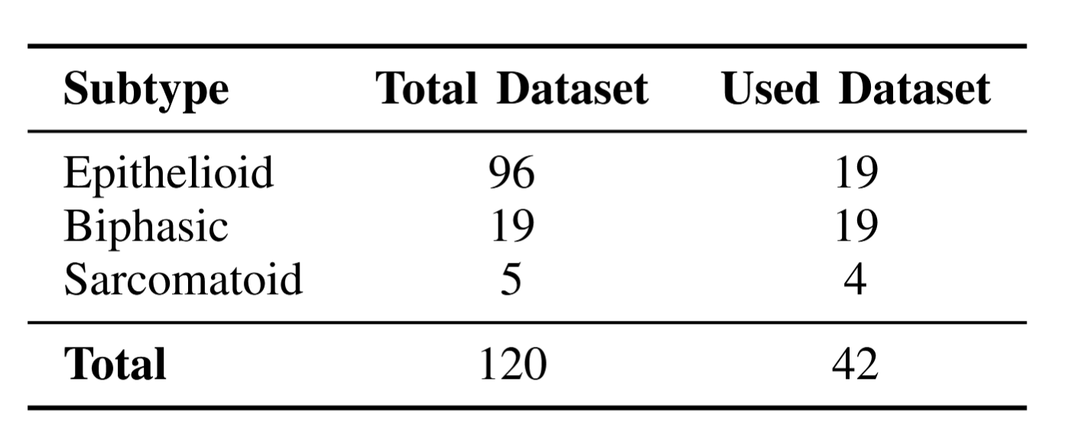
Training details & Dataset used
Learning Rate
10^(-5) UNI, 10^(-4) the rest;
Epochs
20;
Weight Decay
10^(-5);
4-fold cross validation
model configuration
CLAM single branch small model configuration;
8 sample patches for instance-level loss.
Restricted dataset because of class imbalance, poor performance on test runs and complexity of manually extracting features

Slide 13
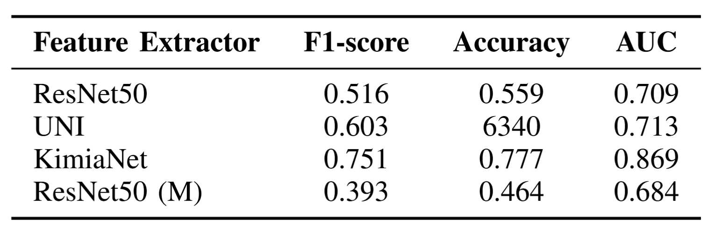
Results
In this project we wanted to evaluate:
Contribution of manually engineered features
How manually engineered features compares with current state of the art base of foundation models:
Average of 4 fold cross validation computed on the model that achieved the best validation accuracy for each fold

Slide 14
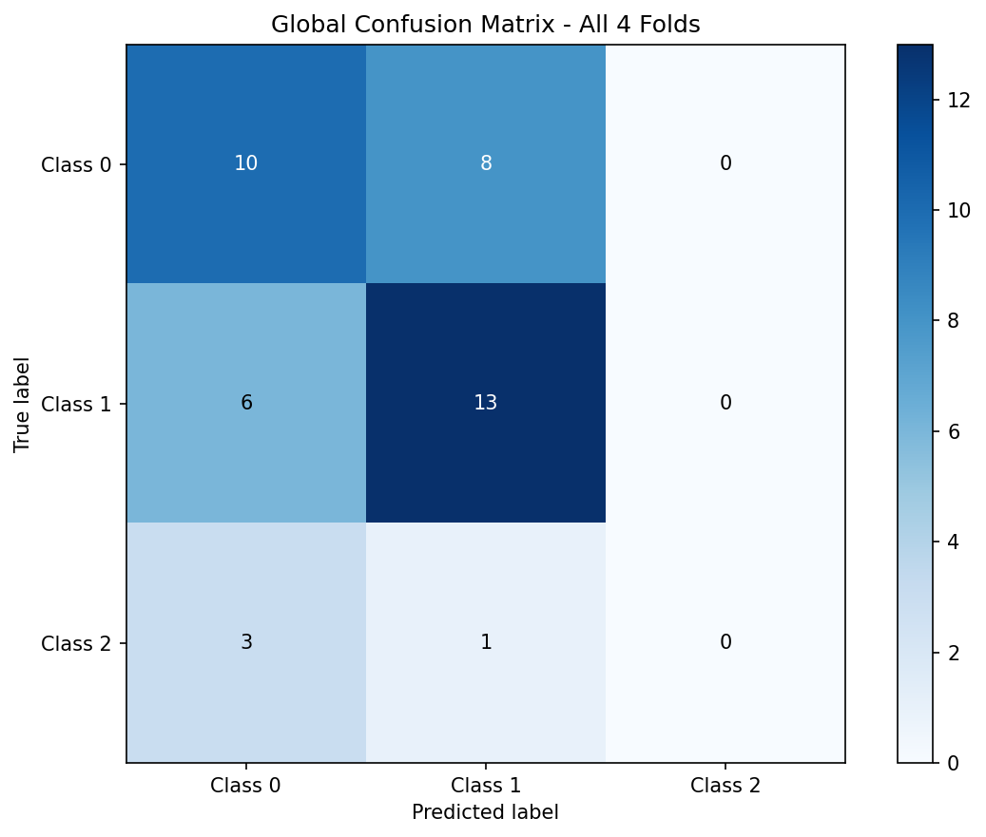
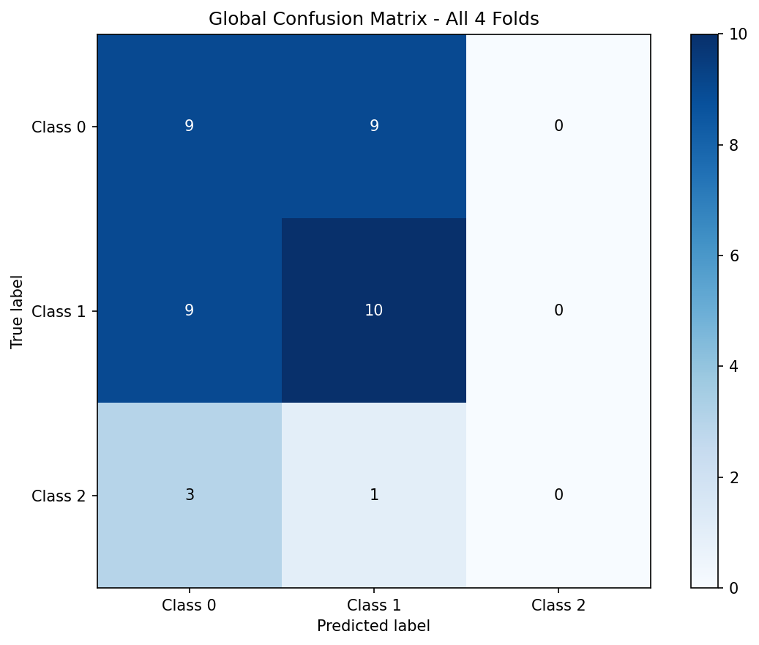
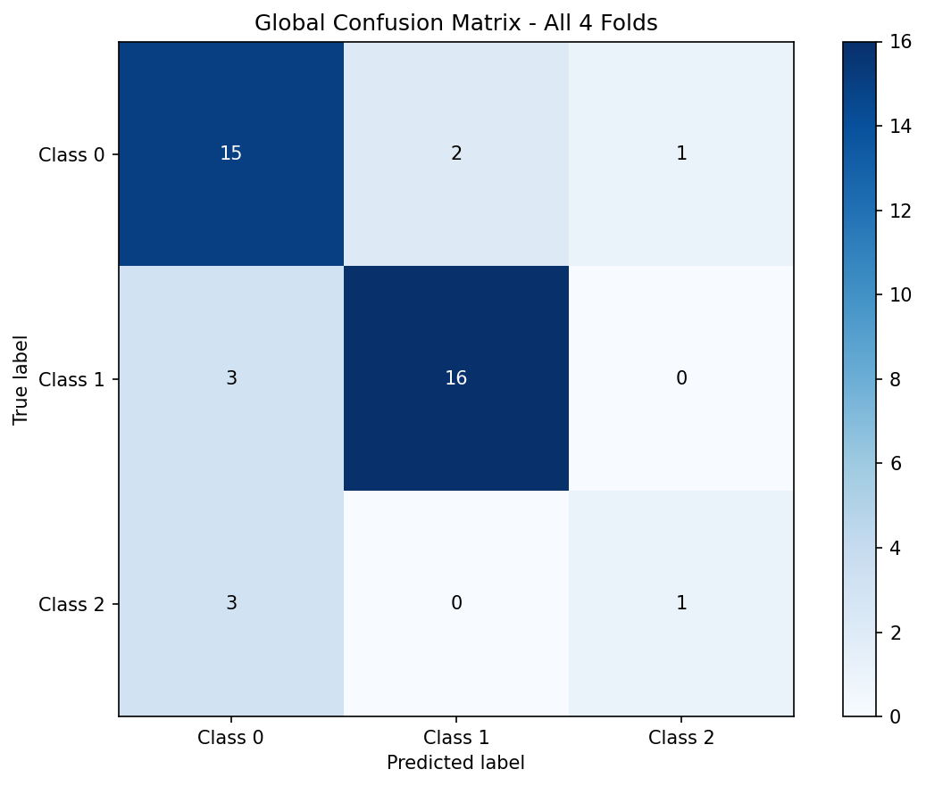
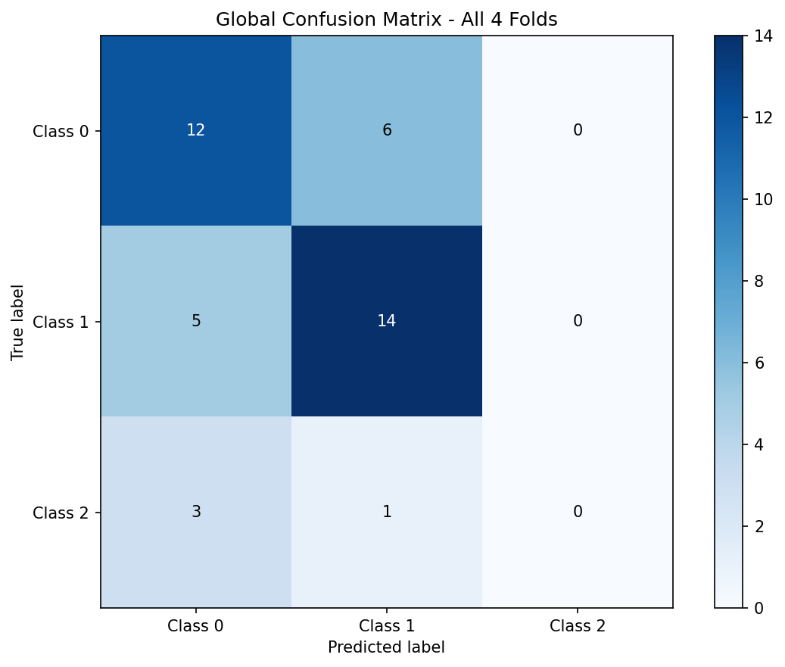
a) Resnet 50:
Struggles to classify the data correctly, but is to be expected.
b) Resnet 50 (M):
Worst performances than simply using ResNet 50 without manual features.
c) KimiaNet:
The best performing it is evident that it is able to classify the data the best, it is the only one that manages to correctly classify a sarcomatoid sample.
d) UNI:
Not the best feature extractor despite being trained on the largest dataset.
a) ResNet 50
b) ResNet 50 (M)
c) KimiaNet
d) UNI
Results - Confusion matrix

Slide 15
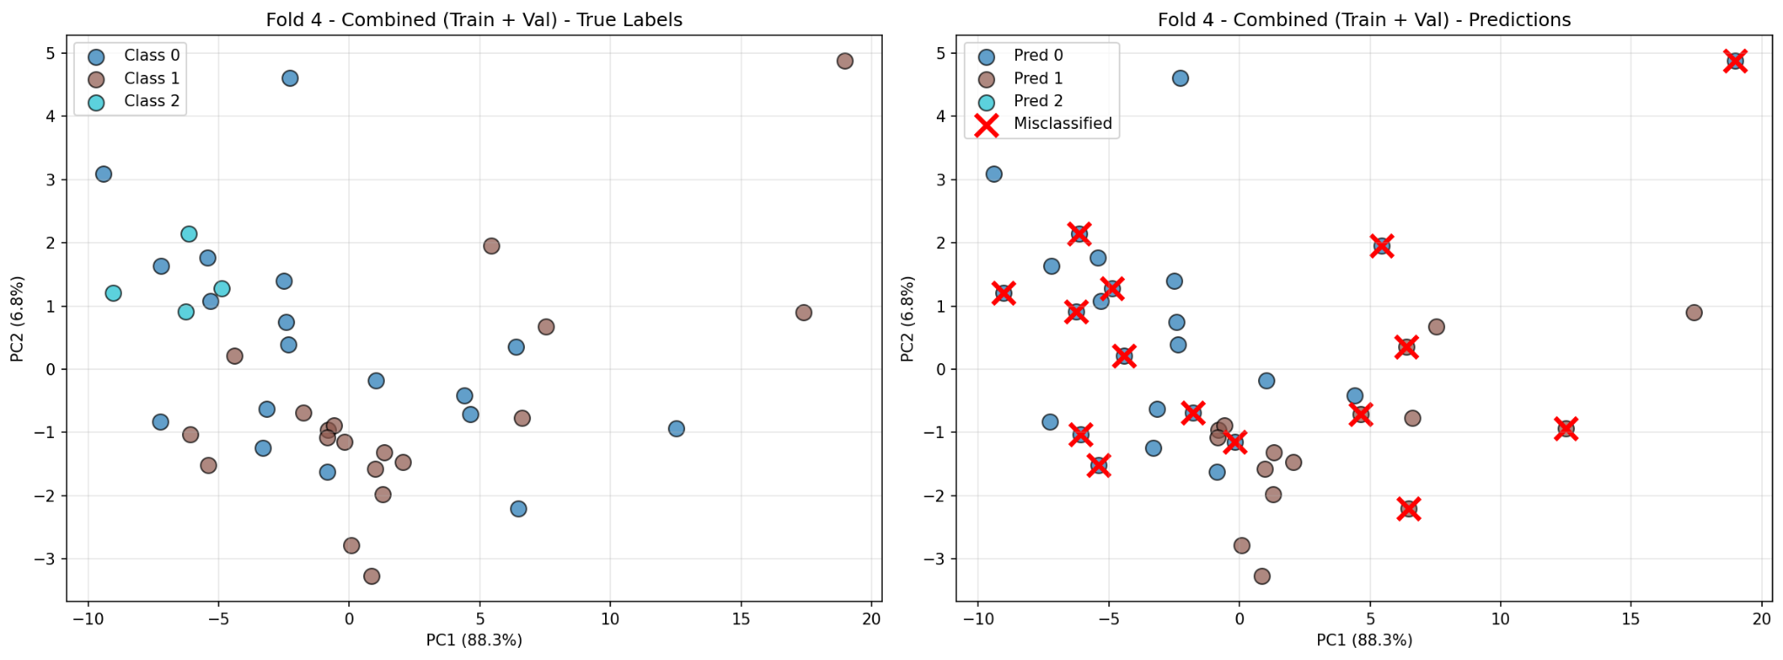
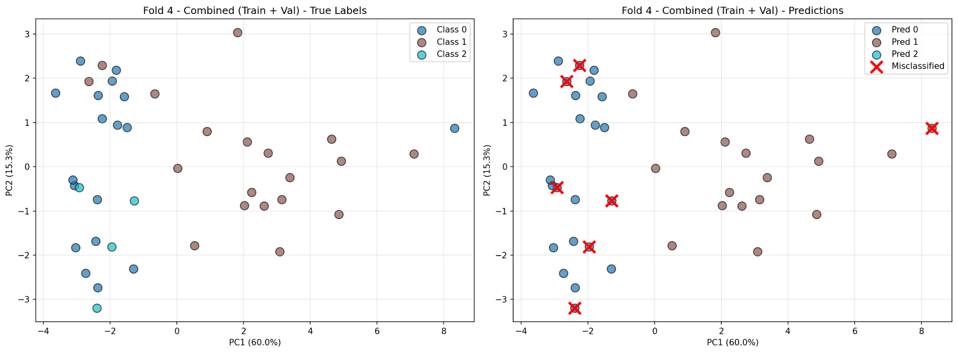
PCA visualization
Resnet 50 (M): From the PCA visualization it is possible to see that internally the features are not well separated leading to confusion when making the prediction.
KimiaNet: On the other end it performs much better since we are able to clearly separate the two main classes, it still struggles with sarcomatoid but that is understandable given the number of WSIs.

Slide 16
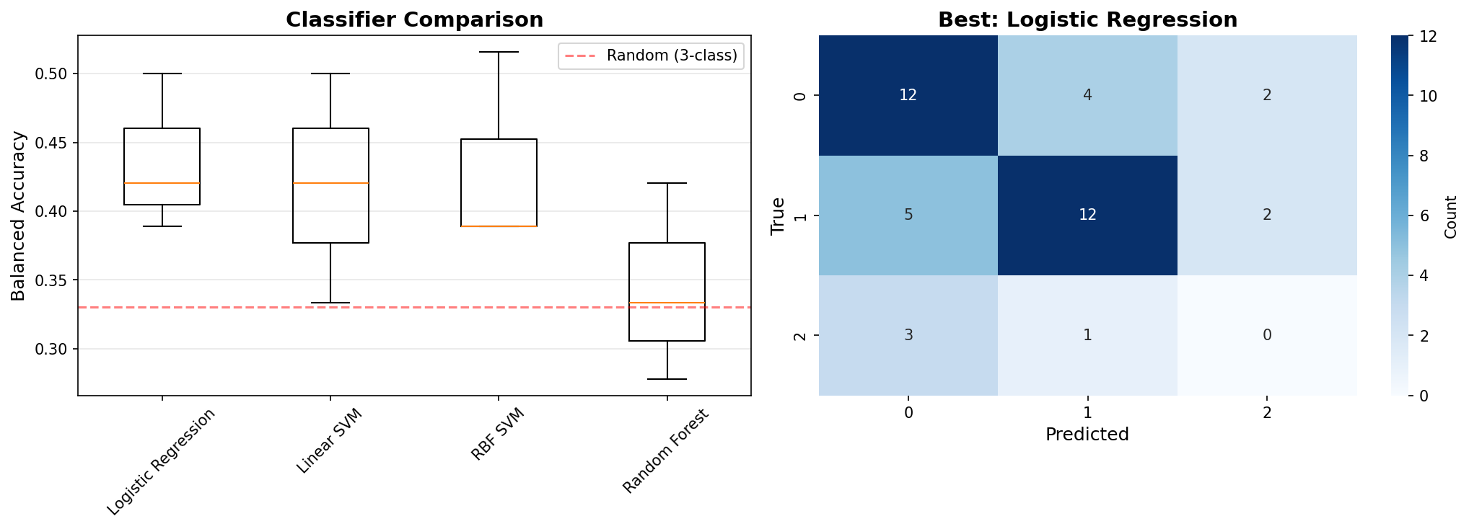
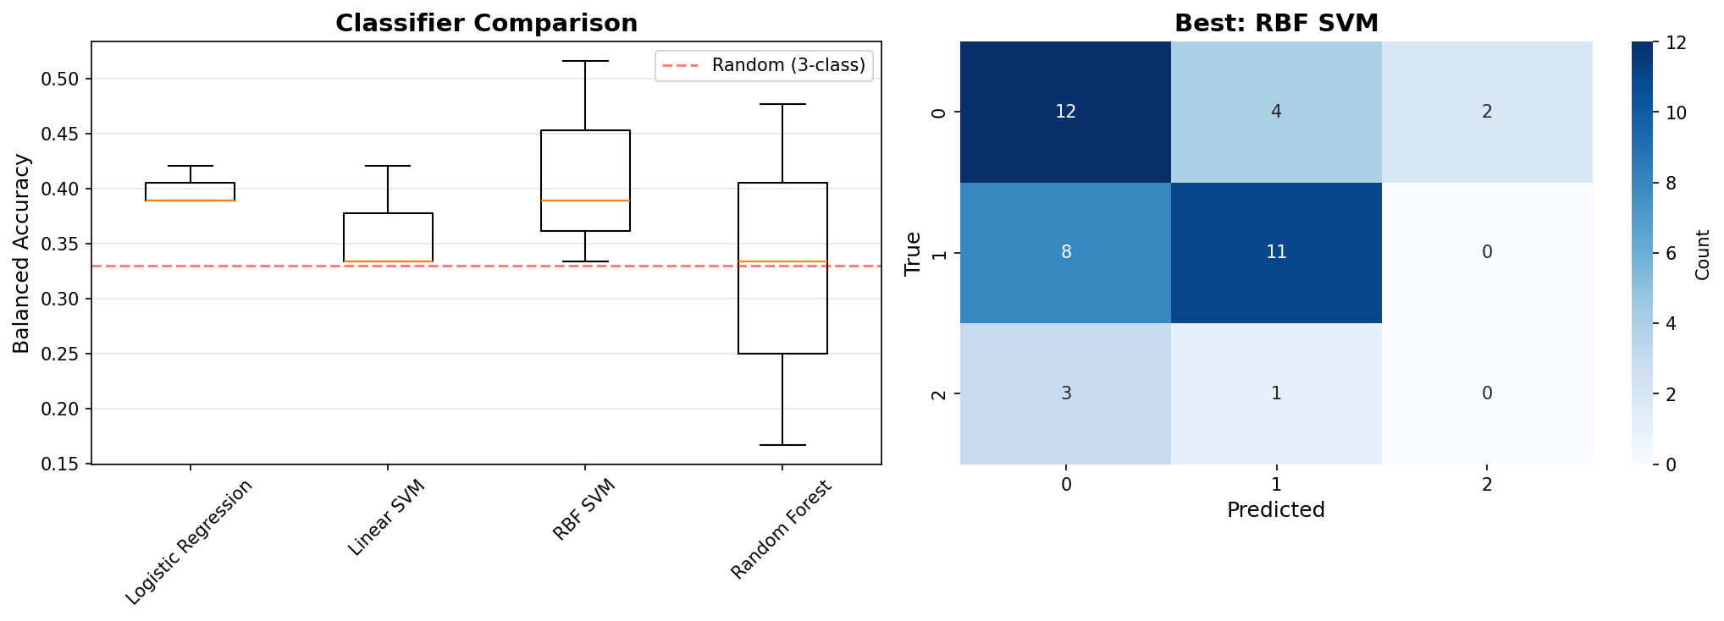
Shallow classifiers benchmark
Resnet 50: Okay performance across different shallow classifiers, this is what we expect from a feature extractor that has not been trained on histopathological data.
Resnet 50 (M): The manually extracted features do not help in the classification process, for Random Forest the accuracy is on part with a random prediction.

Slide 17
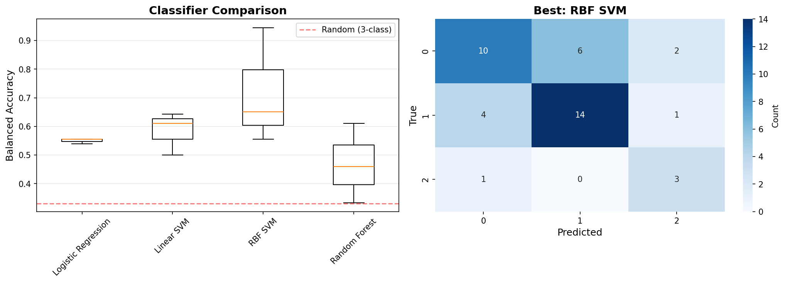
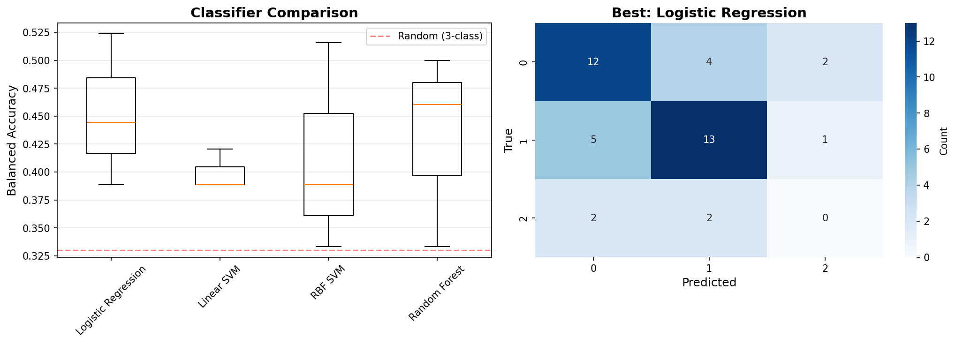
UNI: The best performing on shallow models, indicating that CLAM was the problem. Probably it struggles to separate the richer features with this few images.
KimiaNet: It performs okay, and it is better then ResNet 50, but worst than UNI, meaning that the features extracted by last are more informative overall.
Shallow classifiers benchmark

Slide 18
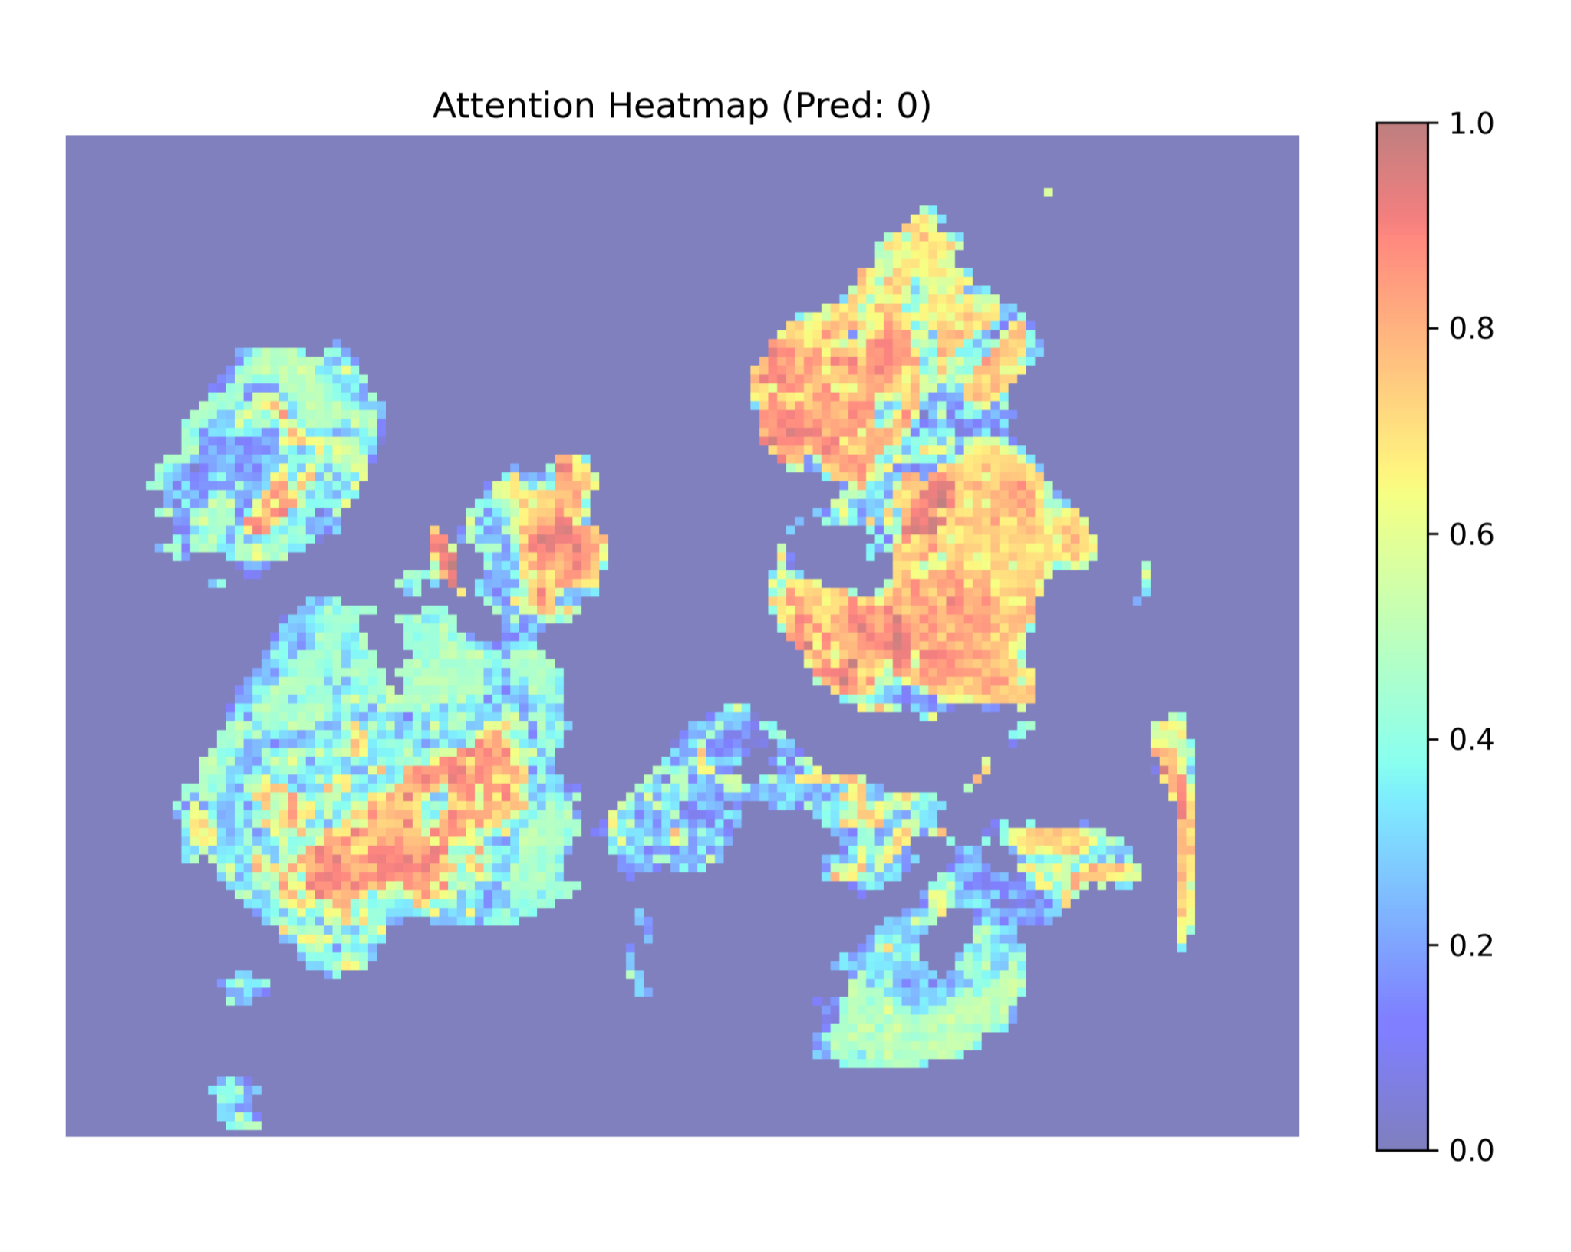
Advantages of CLAM model in real life diagnostics
Heatmap generation
Because of the attention mechanism it is possible to generate a heatmap of the attention weights.
In this way in a real world scenario the pathologist could analyze what areas are important for the classification.

Slide 19
Conclusions
Contribution of manually engineered features:
The features extracted were not informative
Lead to lower performances
Causes:
TMA cores are smaller and easier to work with, requiring less computational power than standard WSI.
Less manual features extracted in respect to the PINS paper
Extremely similar pathologies, difficult to separate with traditional methods
How manually engineered features compares with current state of the art base of foundation models:
Manually extracting features was computationally expensive
Less straightforward than using a base of foundation model
Lower performances
Challenging to understand what features are useful and what are not

Slide 20
Future works
Move away from manual feature extraction:
Improve on current state of the art foundation models that can also be adapted to more task
Improve current data availability with public datasets
Focus on manual feature extraction:
Understand and make publicly available what features work best with each pathology
Introduce libraries to make the feature extraction process more simple
Developing more robust methods to aggregate features extracted manually and extracted using DL.
Two branches

Slide 21
Thank you for your attention

